Slide 1

Department of computer science, university of Salerno,Salerno, Italy,
FAHAD AHMED (f.ahmed@studenti.unisa.it)
SUNBUL (error2@studenti.unisa.it)

Slide 2
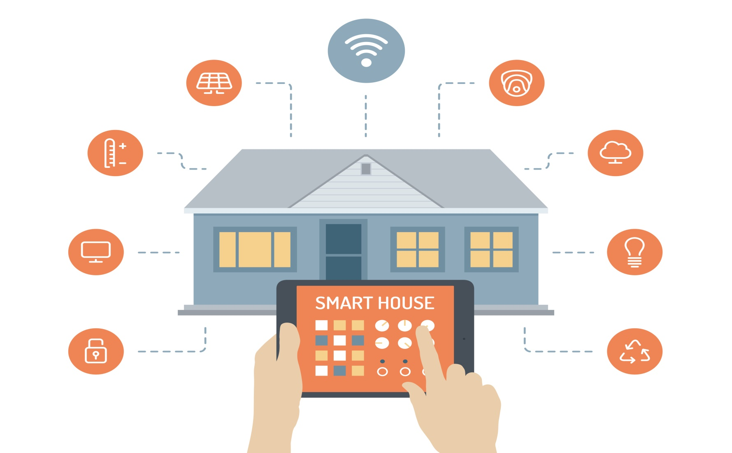
HOME AUTOMATION IoT Powered sensor to Monitor Temperature and Humidity

Slide 3
PROJECT IDEA
Design and construct a home automation system that can be control automatically through smart phone.
The status of each appliances can be view in android app.
Data can be stored in server

Slide 4
WHY IoT ??
Generate, collect, process and use acquired information to make better decisions.
Things could be anything. Physical or virtual.
Things can be interact each other smartly.
Create a social network of sensors

Slide 5
ALTERNATE SOLUTION
ZIGBEE BASED
BLUETOOTH BASED
GSM BASED
But our project is wireless home automation system using IoT.

Slide 6
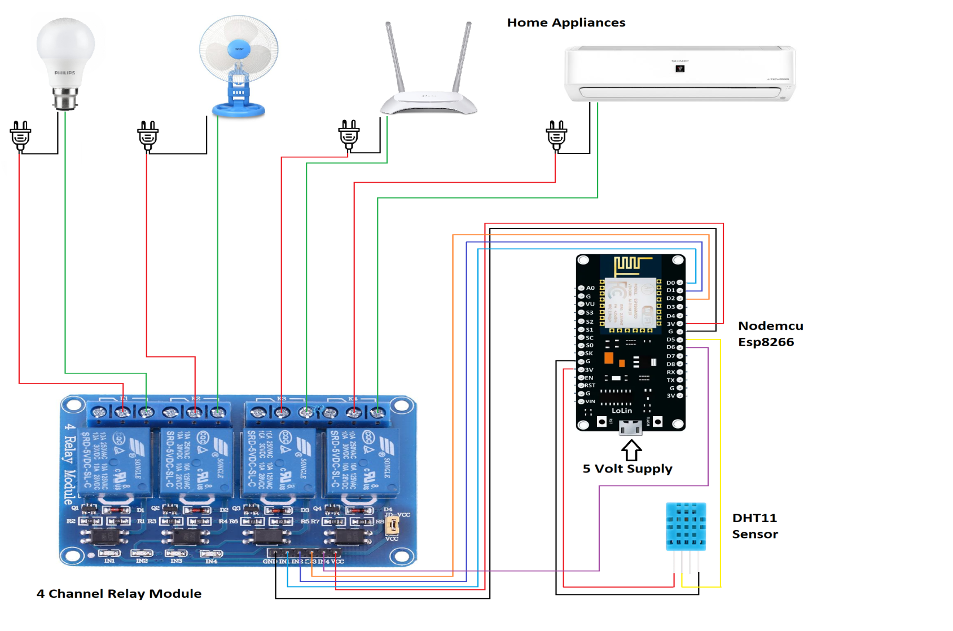
CIRCUIT DIAGRAM

Slide 7
CIRCUIT DIAGRAM DESCRIPTION
5V cell power supply through USB,or Battery cell.
Temperature & humidity can be sensed and can be used to control fan using DHT11.
Relay is used to switch on/off.
Android app is used to control.
NodeMCU is controlling the whole system.

Slide 8
COMPONENTS REQUIRED
HARDWARE
DHT11
Nodemcu ESP8266
Bread board
LED Lights
Jumper wires
4 Channel relay
SOFTWARE
Arduino IDE-C/C++
Android studio-java
Firebase
SQLite

Slide 9
WHY ARDUINO ??
Simplicity – easy to interface & simple coding
Robustness – turn on and off at any time, there is no shutdown of operating system
Low power consumption - easily powered from battery
Cheaper
Suitable for electronic products

Slide 10
Microcontroller based physical computing platform.
Does not need any OS
Need to create sketch in the arduino language(just like C)

Slide 11
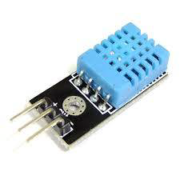
DHT11
Humidity+Temperature sensor
Measurement range: 20-90%RH,0-50’C
Sends data in form of pulses train of specific time period.

Slide 12
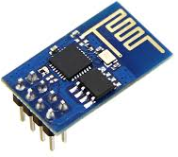
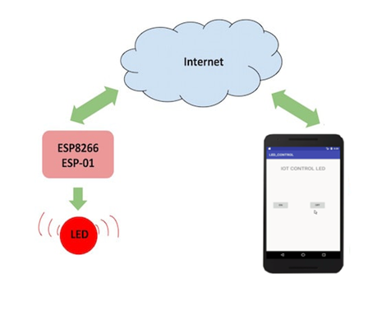
NodeMCU (ESP8266)
NodeMCU is an open source IoT platform.
It includes firmware which runs on the ESP8266 Wi-Fi.

Slide 13
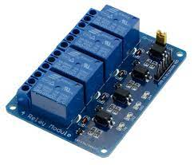
4 Channel Relay
The four-channel relay module contains four 5V relays and the associated switching and isolating components.
Which makes interfacing with a microcontroller or sensor easy with minimum components and connections.

Slide 14
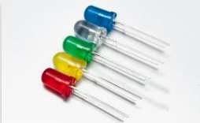
LED LIGHTS
LED stands for light emitting diode.
LED lighting products produce light up to 90% more efficiently than incandescent light bulbs.

Slide 15
PROS & CONS
Adding Convenience to your Daily Life.
Energy efficient
Customization
Ease of Use
Save Money and the Environment
Security
Equipment and installation costs
System crashes due to any damage in the interconnection
Reliability
Difficult to control different sensors simultaneously.

Slide 16
CONCLUSION
This is an on going project and our prime objective is to assist handicapped/old aged people.
This project gives basic idea about the controlling of home appliances and provide a security using android.
In future it can be expanded to many other areas.

Slide 17
DEMO

